Slide 1
AMAZON SALES
DATA ANALYSIS REPORT
Name: HARIPRASATH. S

Slide 2
Objective
Benefits
Problem Statement
Sales management has gained importance to meet increasing competition and the need
for improved methods of distribution to reduce costs and to increase profits. Sales
management today is the most important function in a commercial and business
enterprise.
Help out to make better business decisions.
Help analyze customer trends and satisfaction, which can lead to new and better products and services.
Gives better insight of customer base.
Helps in easy flow for managing resources.
Develop a Report by Extracting-Transforming-Loading data that contains Sales trends for Year, Month, and Quarter and find Some relationships through data to understand and Analyze the Facts.

Slide 3
Quick Insight
76
Total country
44M
Total Profit
12
Product type
2
Sales channel

Slide 4
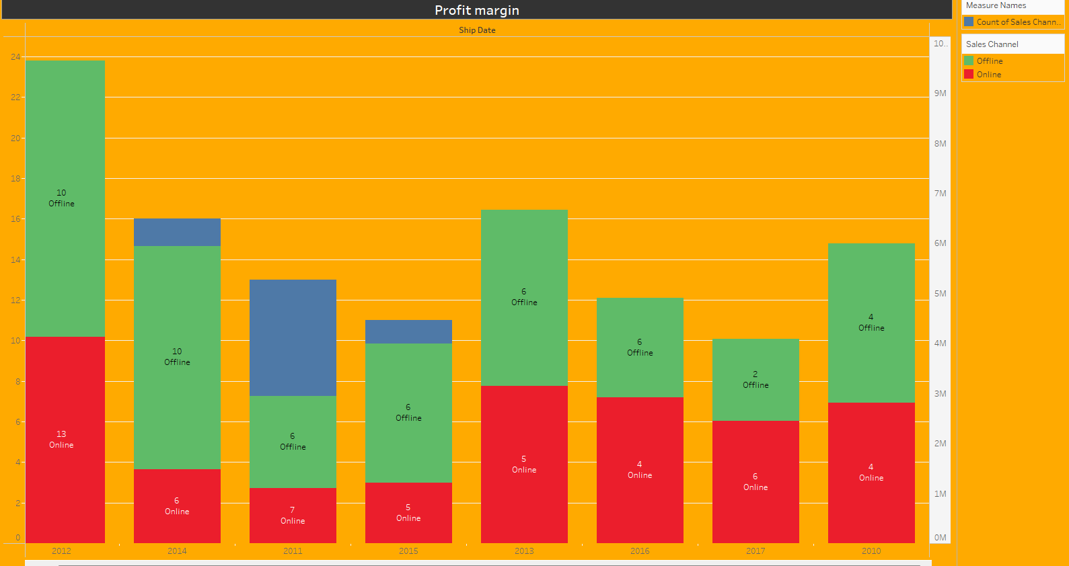
Total Profit
According to the chart, the company's highest profit sale occurred in 2012.

Slide 5
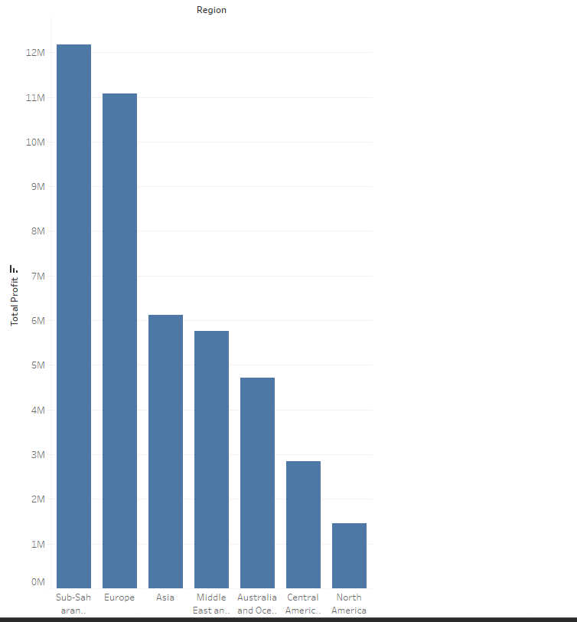
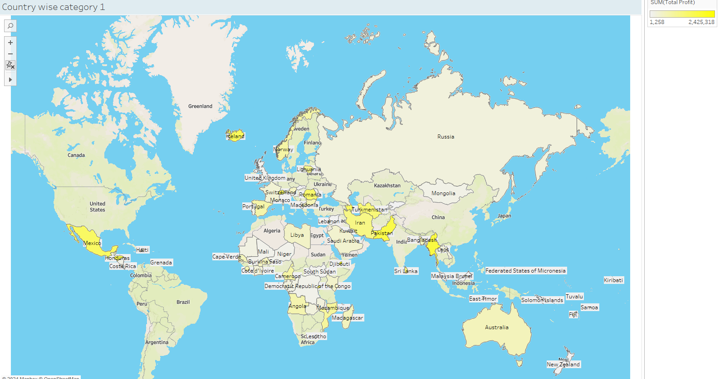
Top Regions of customers
"The Sub-Saharan African region is known for its high volume of sales."

Slide 6
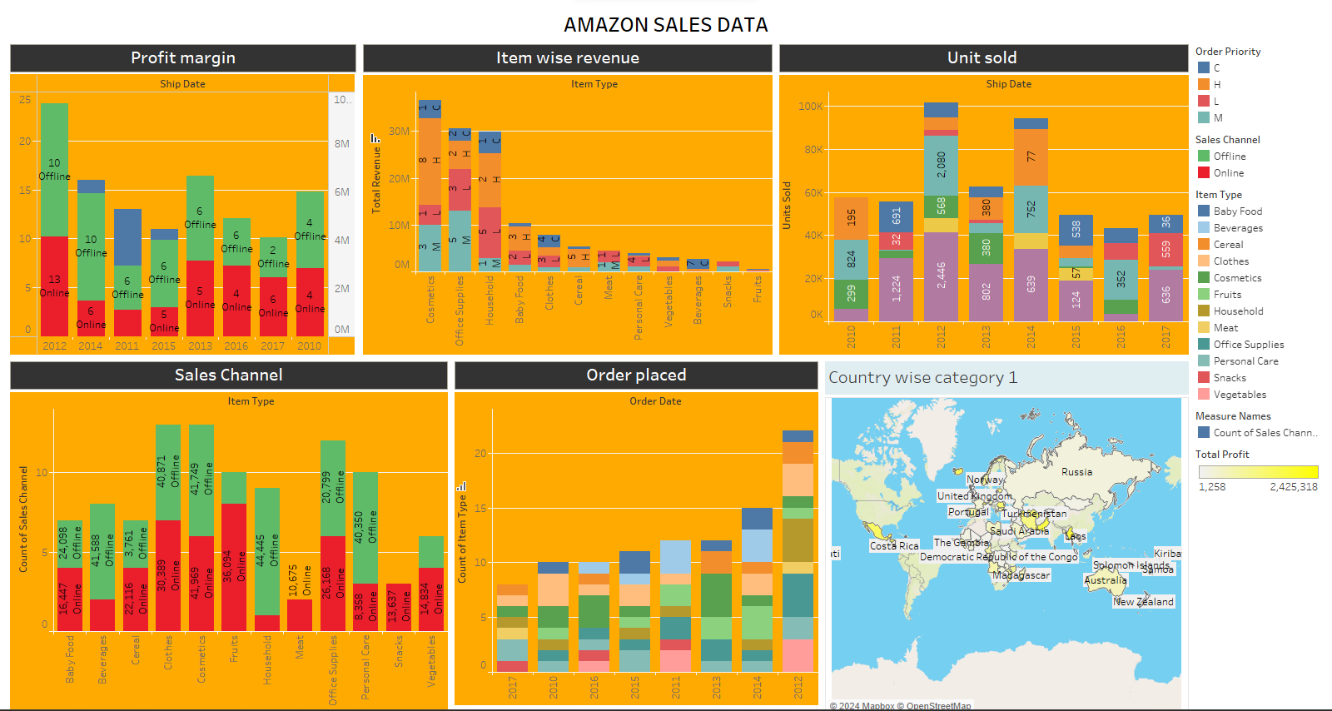
DASHBOARD

Slide 7
Conclusion
The company's profit margin is higher for online sales than offline sales.
The company's top-selling items are in the "Food" category.
The company's sales are growing in all three countries shown (Russia, Saudi Arabia, and Costa Rica).
Unit sold: This is the number of units of each item that were sold. The data shows that the highest-selling items are "Oats" and "Baby Food".
Order priority: This is the priority level assigned to an order. The data shows that the majority of orders are "Standard" priority.

Slide 8
UNIFIED MENTOR INTERNSHIP
Details:
1 Month of duration- DATA ANALYST
Name: Hariprasath. S
Internship ID: UMIP3519
E-mail: hariprasathof26@gmail.com
Duration: February 1 to March 2

